Slide 1


WPSU Government Relations Committee
Greg Petersen, Gary Miller,
Matilda Illuzzi, Vince Mannino
Meeting on 5.5.20

Slide 2
Letters to the Editor - WPSU “Learning at Home” April-May 2020
Tim Asinger - Bradford Era
Sherry DelGrosso - Altoona Mirror
Kelly Hastings - Lock Haven Express
Matilda Illuzzi - Dubois Courier Express
Jennifer Judd - Bedford Gazette
John Lancy - Clearfield Progress
Joe Nairn - Warren Times Observer
John Pozza - Brookville Jeffersonian Democrat/Punxsutawney Spirit
Vince Mannino - Lewistown Gazette
Greg Petersen - Indiana Gazette
Greg Petersen - Johnstown Tribune Democrat
Greg Petersen - Mainline - (Ebensberg, Northern Cambria, Nanty Glo, Cresson, Gallitzin)
Greg Petersen - Huntingdon Daily News & Tyrone Daily Herald
Gary Miller - CDT
Gary Miller - Potter Leader-Enterprise
Gary Miller - Wellsboro Gazette

Slide 3
WPSU “Learning at Home” Push to Legislators
May- June 2020
Plan is to revamp Letter to the Editor
to include “Learning at Home” initiatives
and
Outline extended Covid19 programming and news
Timing would be as:
State legislators - 2021 Budget – DCED funding
and
Federal legislators - proposals/passage - Covid19-related bills

Slide 4
On May 15, 2020, the U.S. House of Representatives passed the Health Economic Recovery Omnibus Emergency Solutions (HEROES) Act, by a partisan vote of 208-199. While it is unlikely that this legislation will become law in its current form, it included some provisions that could be helpful for stations if they were enacted.
Education Funding
The HEROES Act includes $90 billion for Education grants to governors to support K-12, public institutions of higher education (IHEs) and early childhood education.
Of the funds received by each State, 65 percent (or approximately $58 billion) would go to local educational agencies (LEAs) and 30 percent would go to public IHEs (approximately $27 billion).
Among other uses, these funds may be used to establish or expand remote learning services of the kind public television stations are already providing, often in formal partnerships with LEAs, in all 50 States. This flexible funding can also support:
Delivering educational instruction, planning and implementing summer learning, training and professional development, and providing school-based support such as mental health services, family engagement efforts, and counseling resources.

Slide 5
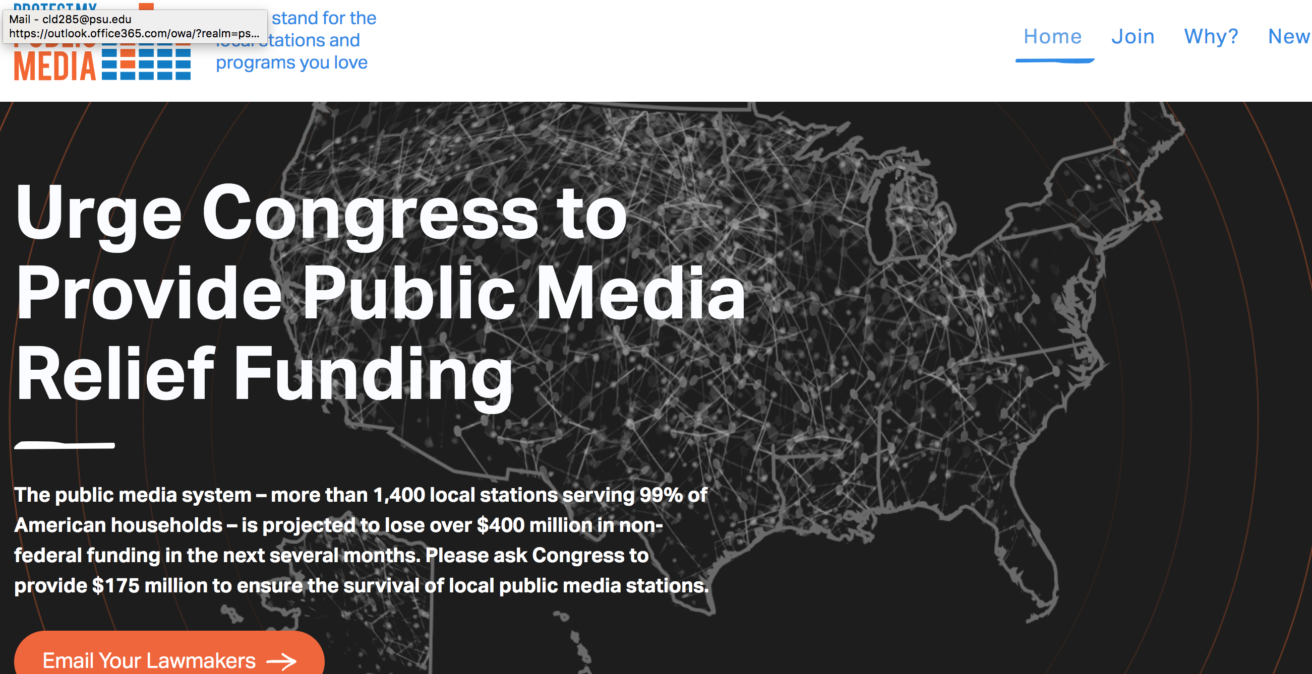

Slide 6


