Slide 1

A collaboration of seven public television stations with the Pennsylvania Department of Education
Phase One: April 10 – June 30, 2020
Phase Two: July 1, 2020 – September 6, 2020
Phase Three: Starting September 7

Slide 2
WPSU Learning at Home Components
The WPSU Learning at Home initiative has three components:
Television programming blocks
Organized by subject and grade level.
HD Channel: 6:00 am – 12:00 p.m., pre-K to grade 3
HD Channel: noon–6:00 p.m., grades 4 through 12
WPSU World Channel, noon- 5:00 p.m. grades 6 through 12
At-home lessons and activities
Coordinated with weekly programs
Relying heavily on pbslearningmedia.org content library
WPSU Education Website
Portal to PBS LearningMedia™, PBS Parents, and other resources
Sections for parents, and caregivers, and educators

Slide 3
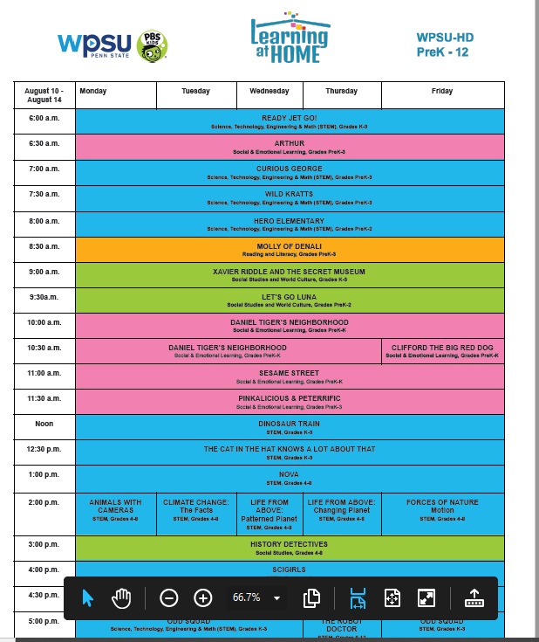
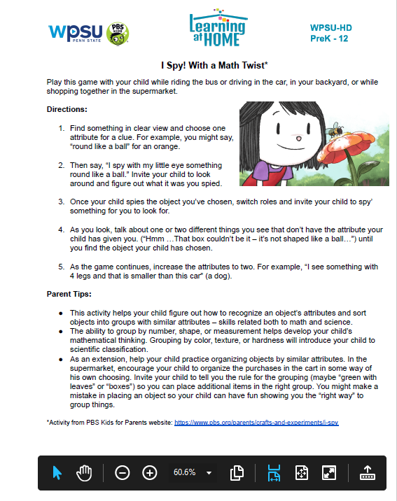

Slide 4


Slide 7
Marketing Communications
Update website weekly with new schedules and activity list
WPSU Weekly Learning at Home Newsletter email – sent to WPSU KIDS and Families List. 1,020 subscribers
PDF one sheet distributed by Carolyn and Kate
Weekly Facebook posts, driving traffic to WPSU Learning Families Group and wpsu.org/learn
Daily Facebook posts on WPSU Learning Families Group
Weekly Instagram posts featuring one of the programs or grade levels
DIGITAL / SOCIAL

Slide 8

WPSU - Learning at Home
Pennsylvania PBS partnership with PA Department of Education
(https://learningathomepa.org/)
Connections with:
Intermediate Units 8, 9, 10, and 11
STEM Ecosystem & PA Keys
Weekly meetings with PDE
Bi-weekly meeting with Education units at seven PBS stations
Grant funding – LAH Initiatives & Offline Families Partnership

Slide 9
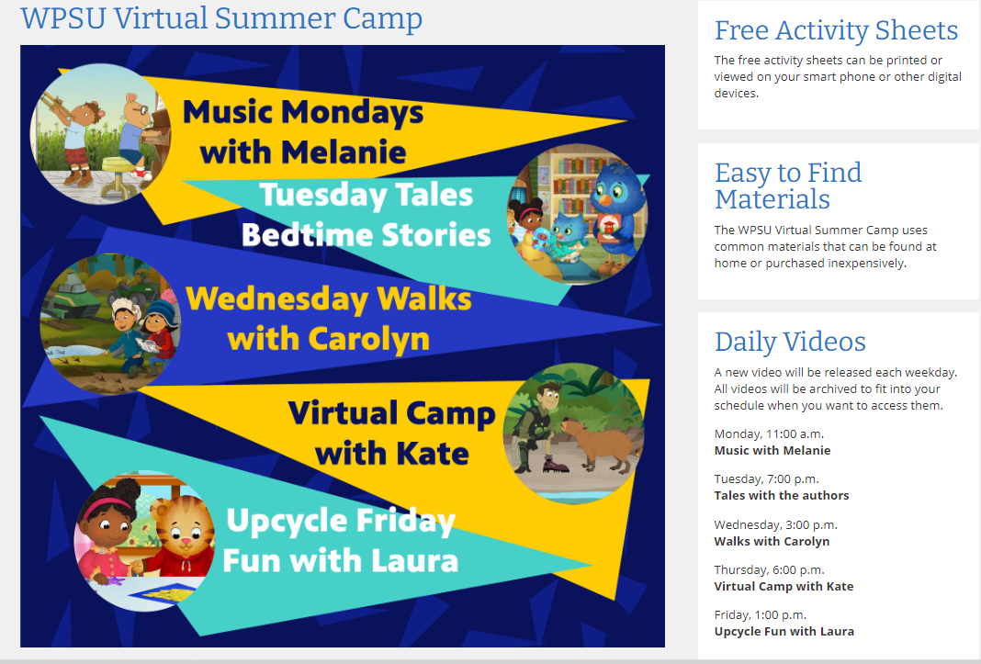
Virtual Summer Camp

Slide 10
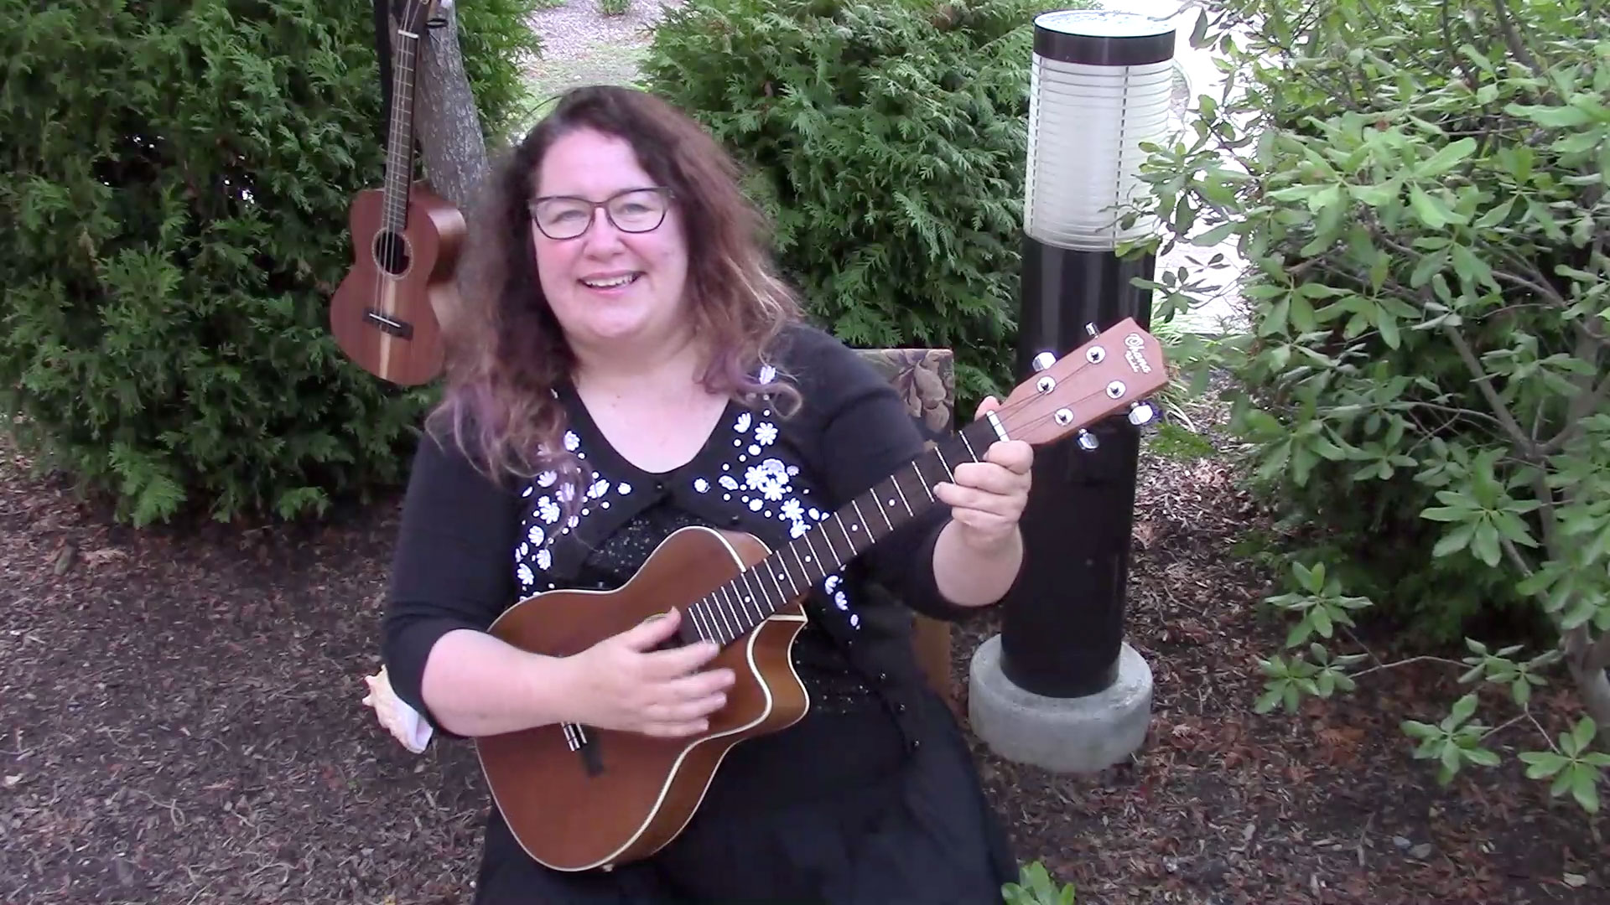
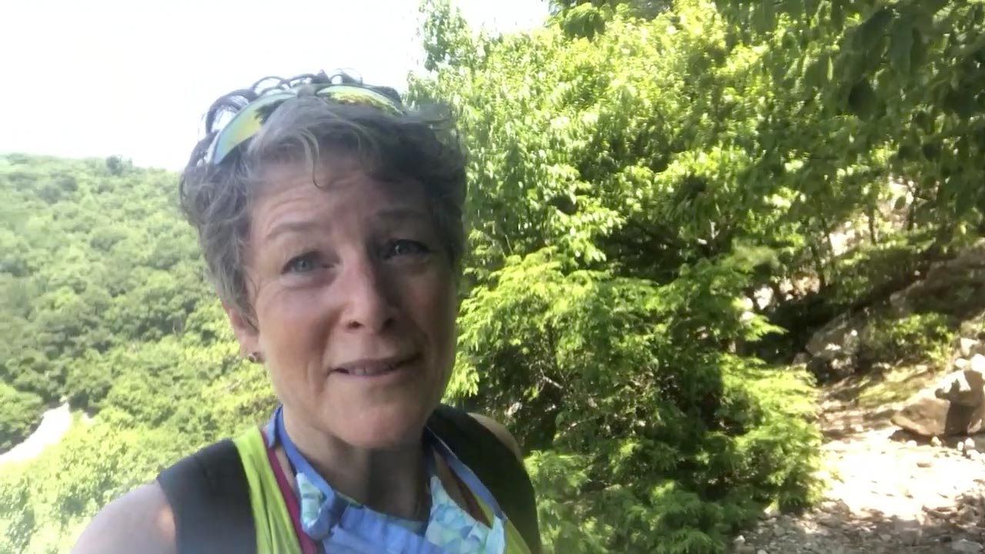
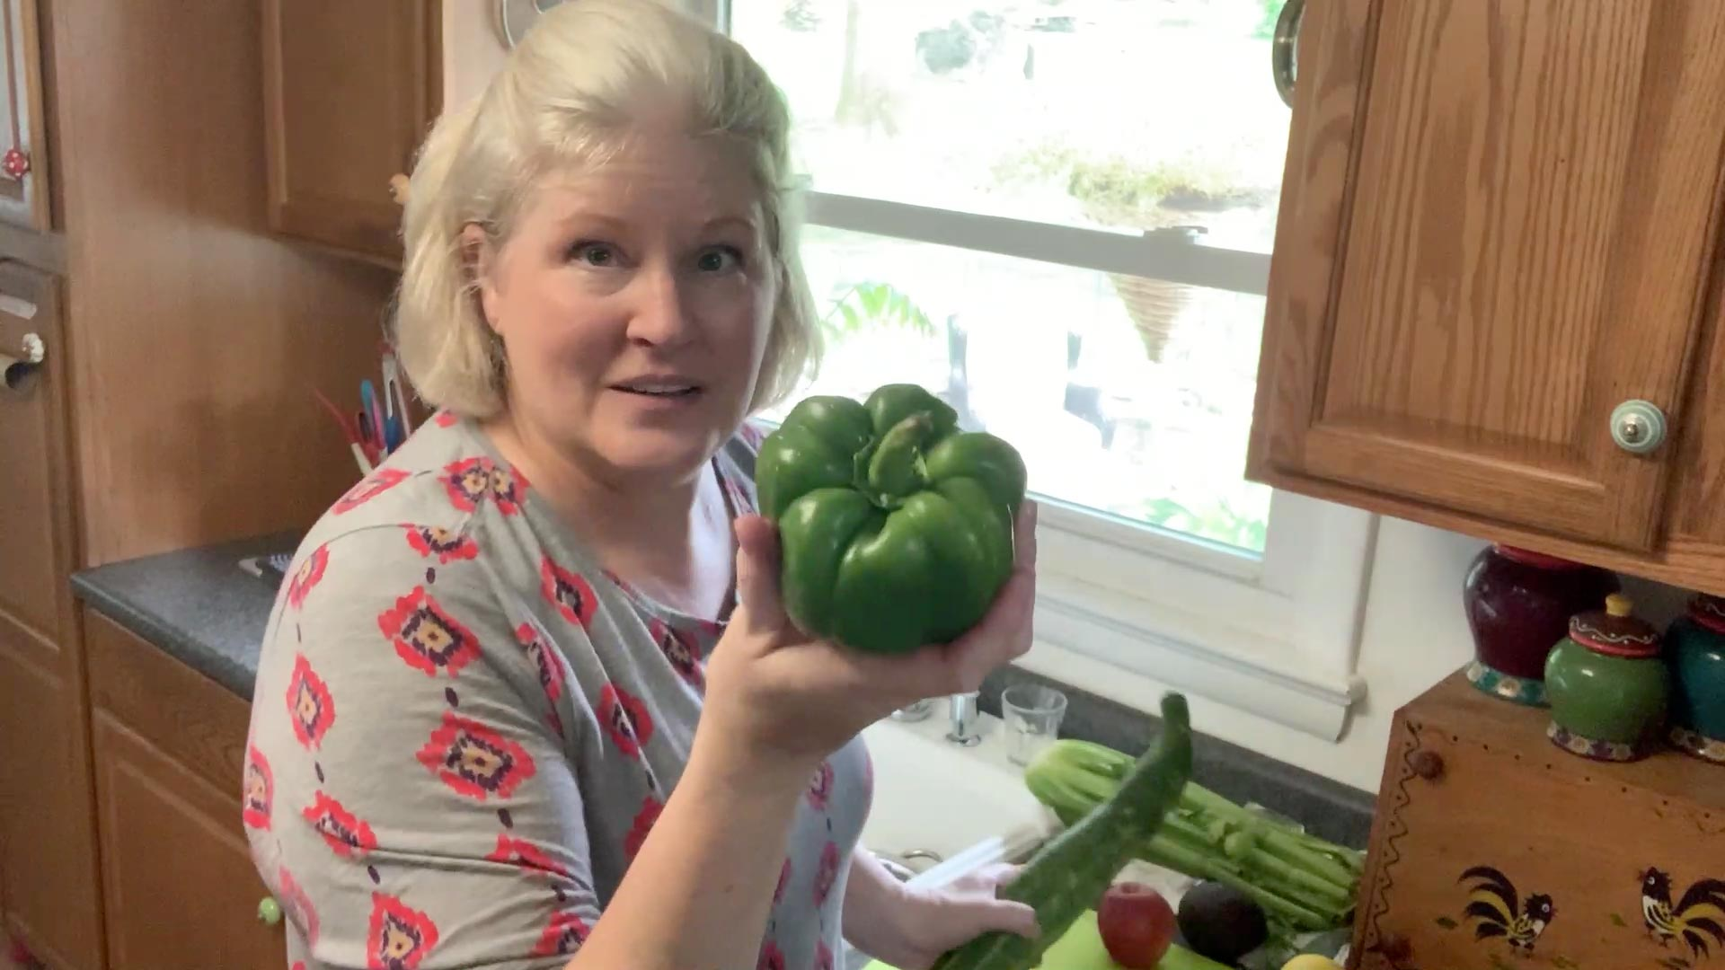
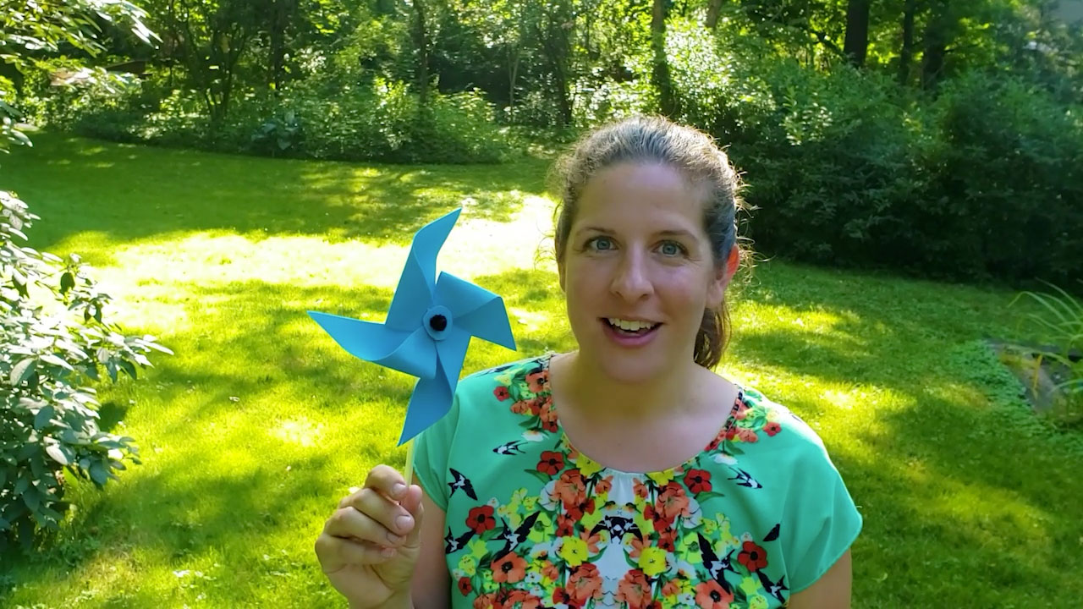

Slide 11
Grab & Go Bags
Funding from from PDE Learning at Home grant
Purchased string bags & school supplies to stuff 3600 bags
18 items per bag from crayons, markers & scissors to PBS book, sketch pad and journal
Stuffed using staff and volunteers over 2 ½ days
Delivered to students 10 and under through Summer lunch program at State College Area SD, Altoona SD, Tyrone SD and YMCA Anti-Hunger Program

Slide 12
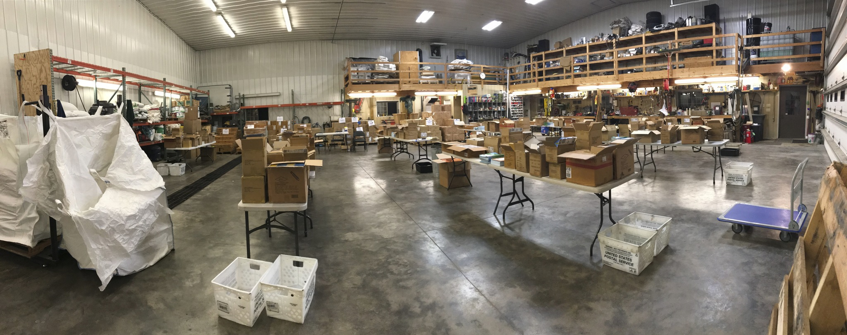

Slide 13
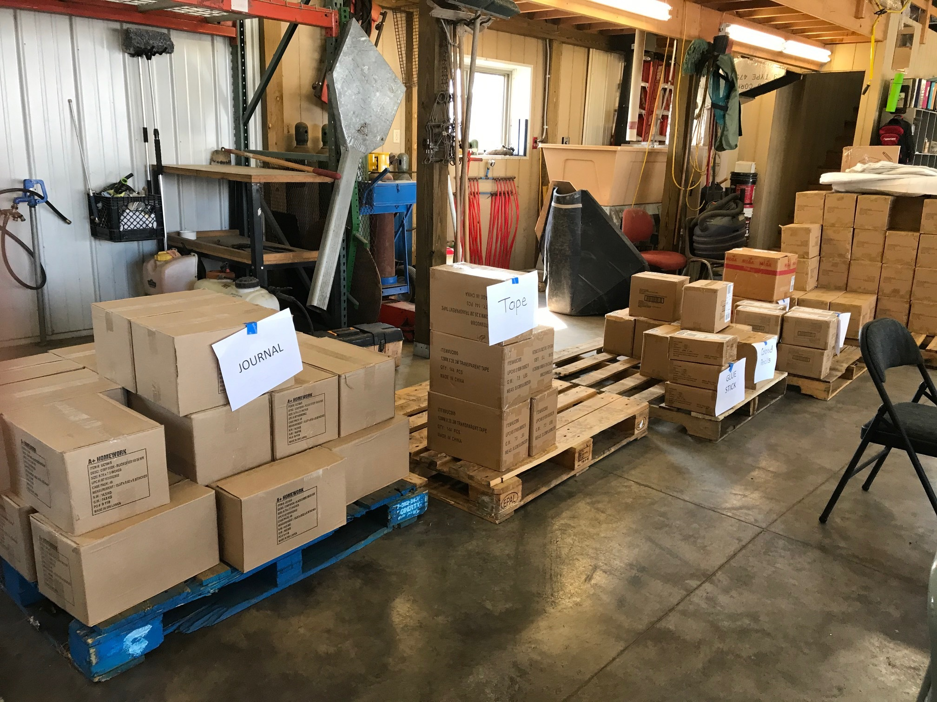

Slide 14
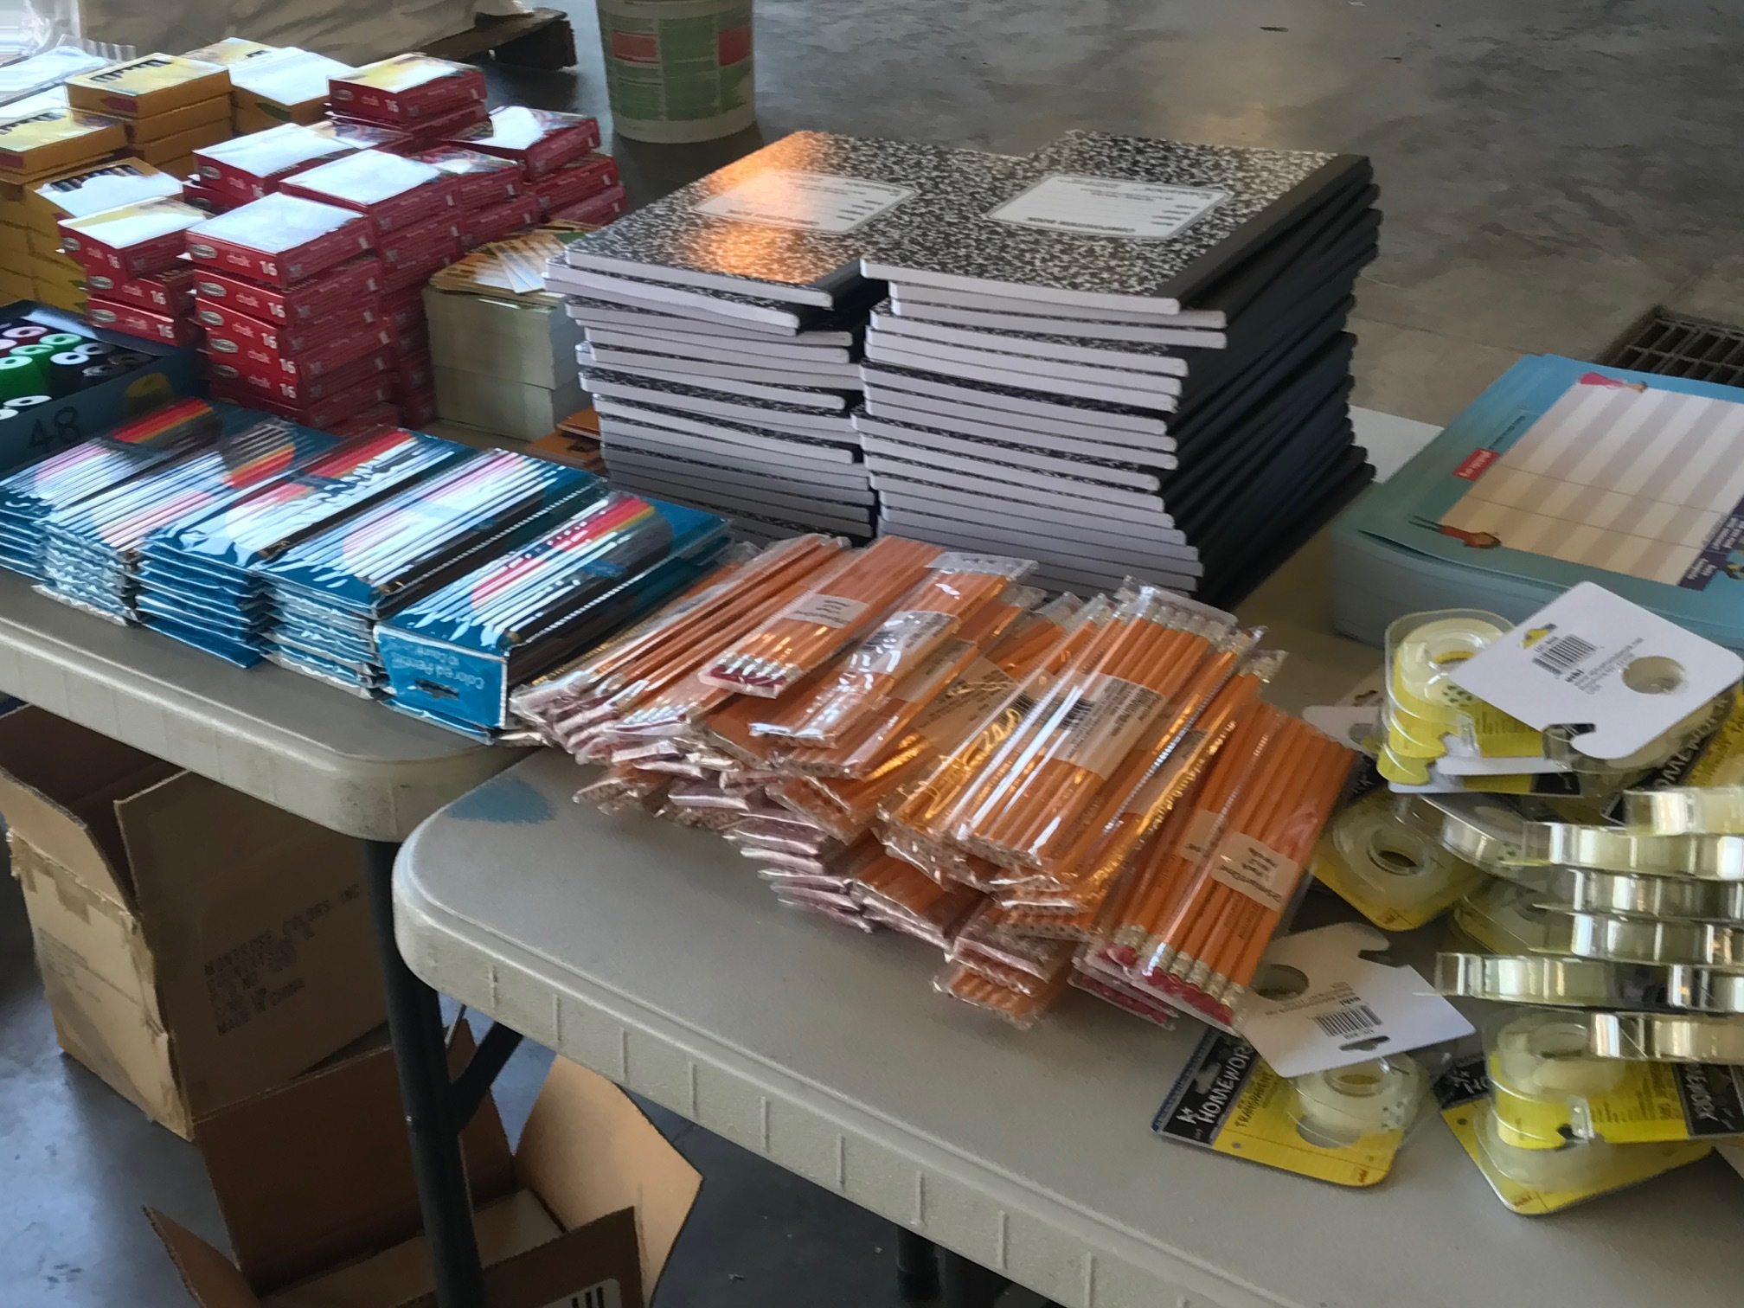

Slide 15
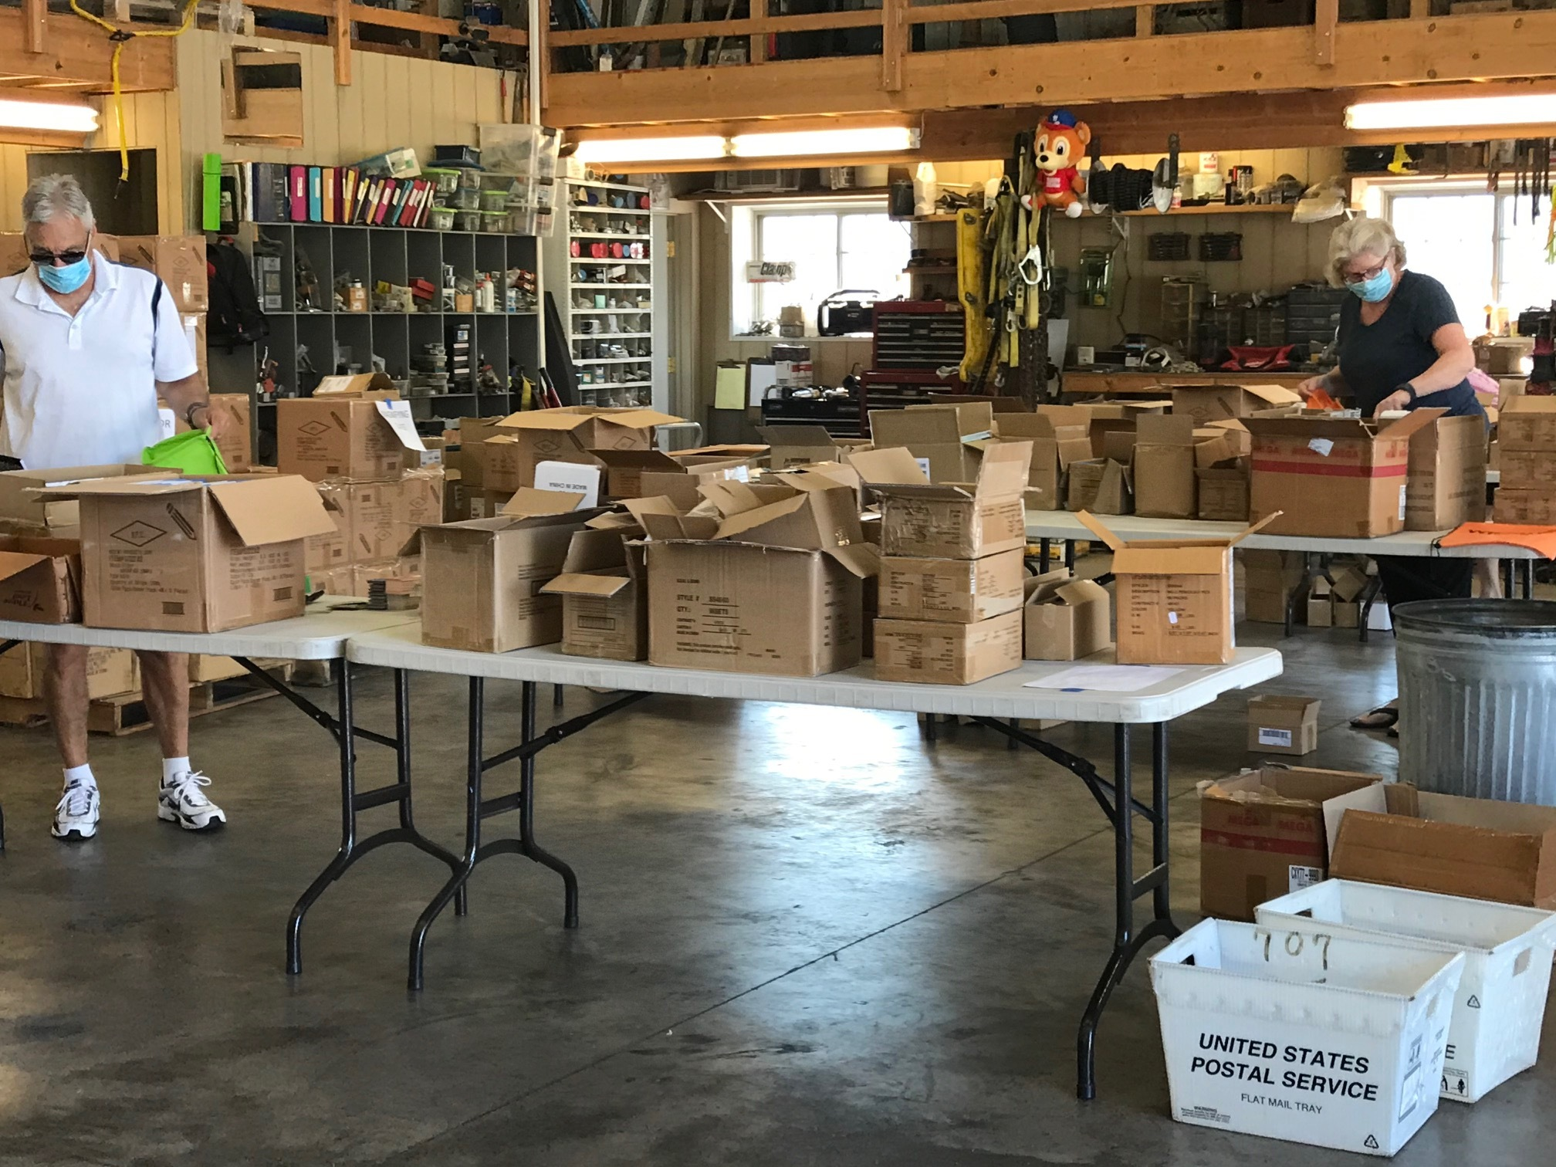

Slide 16
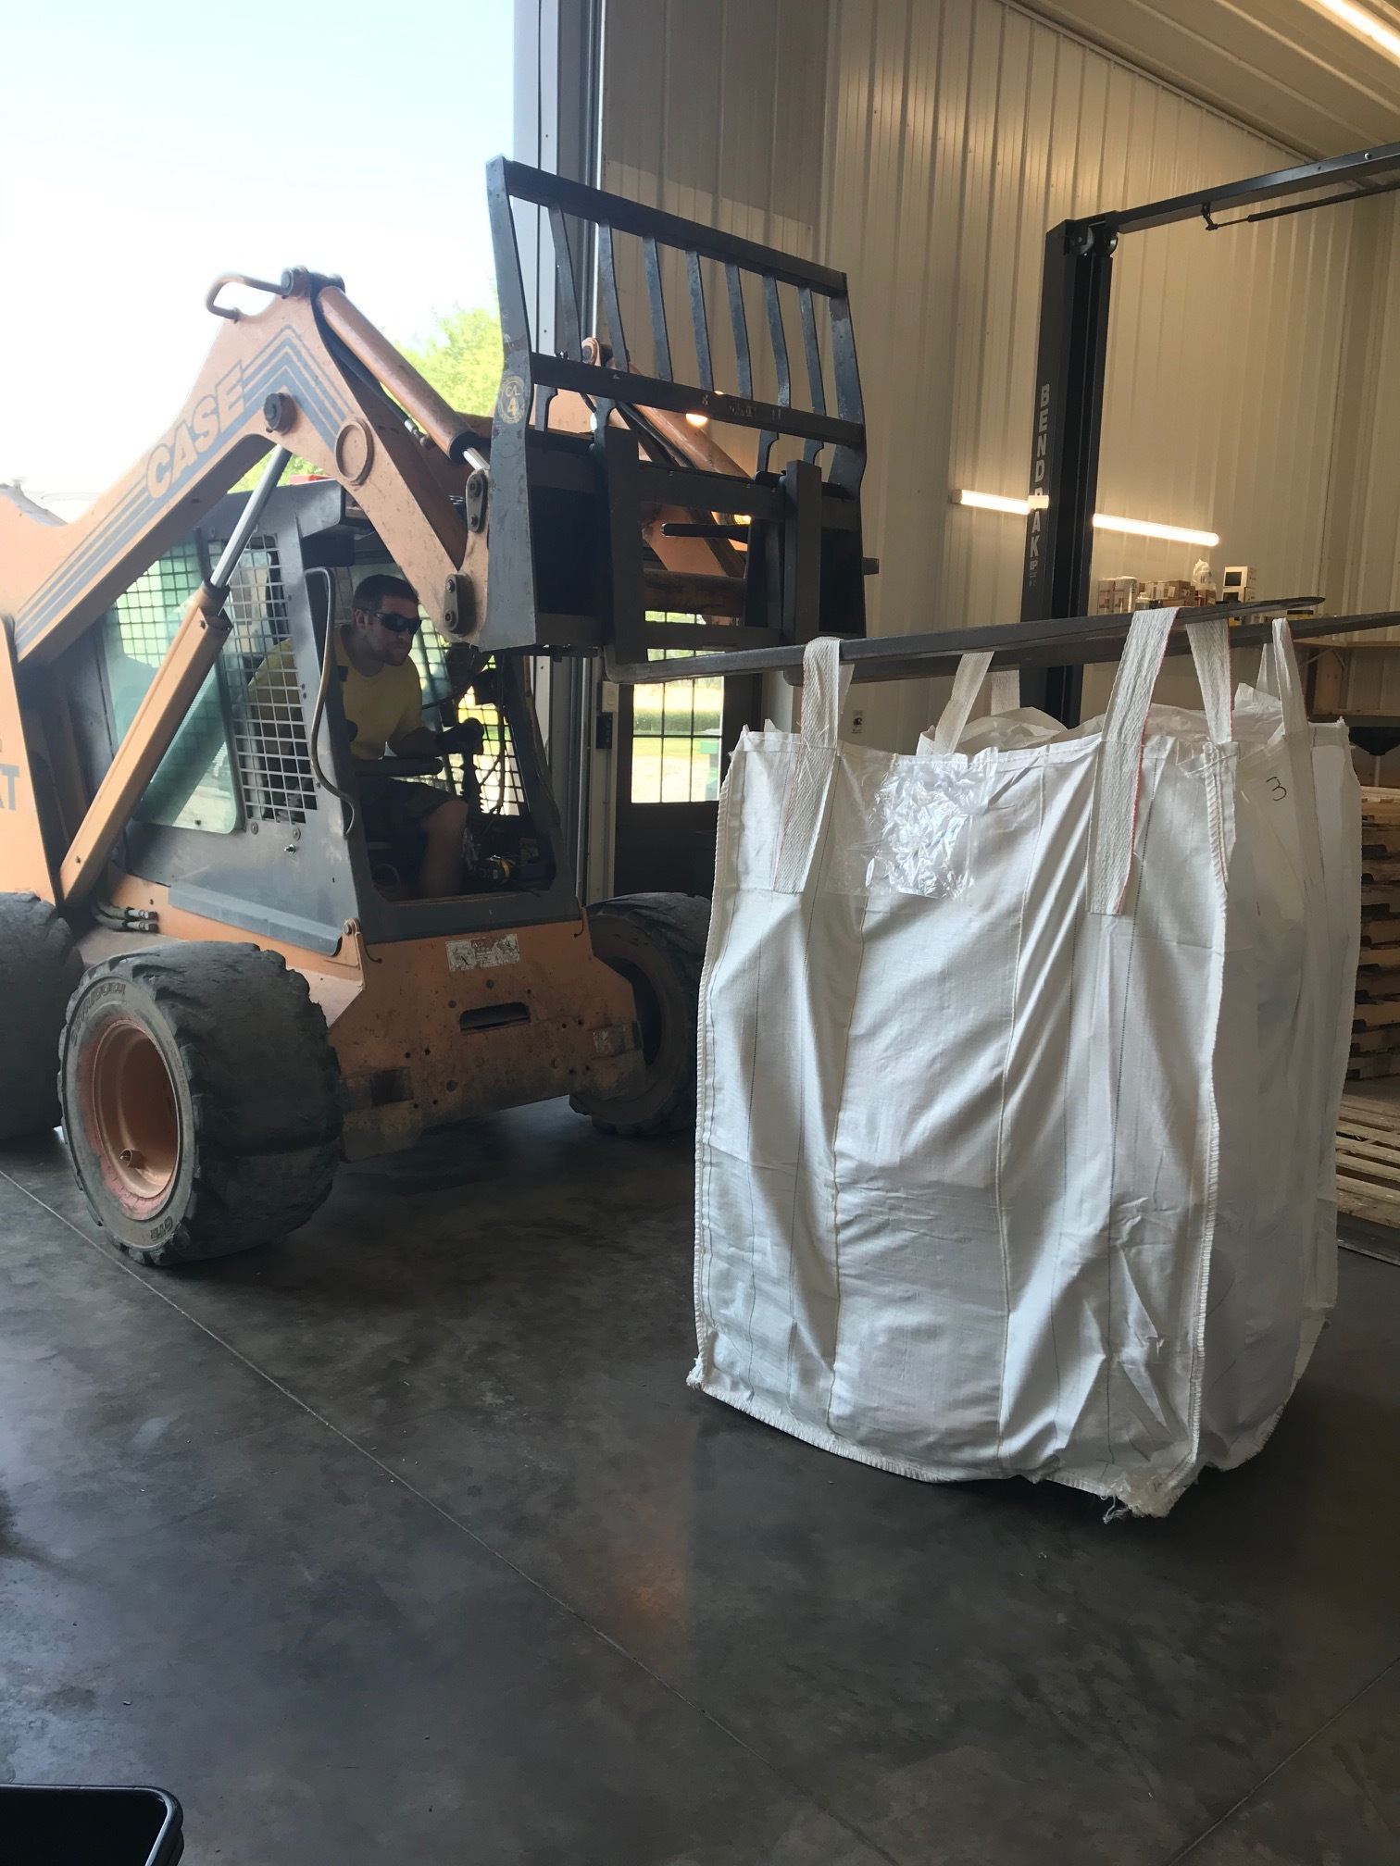

Slide 17
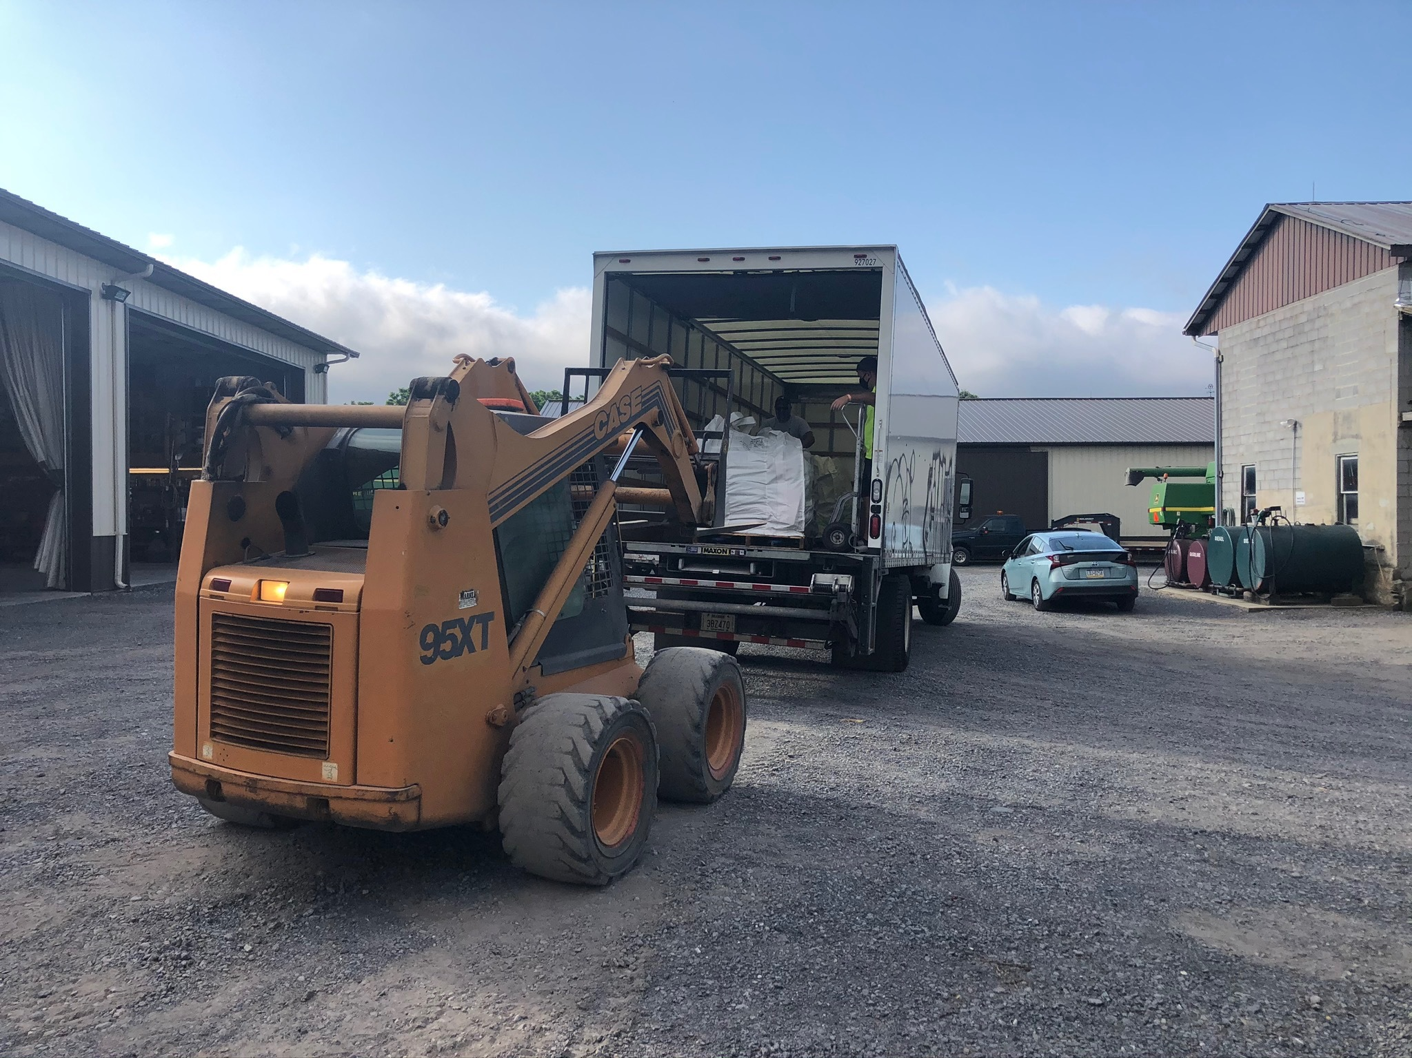

Slide 18
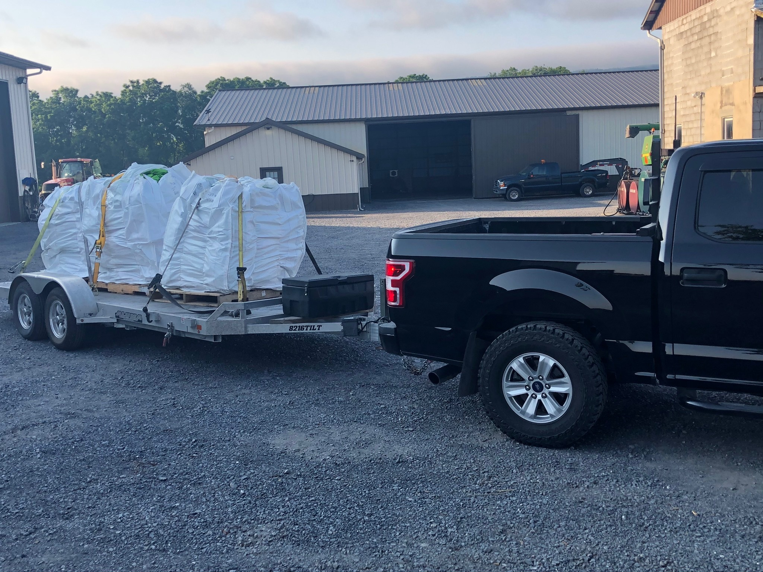

Slide 19
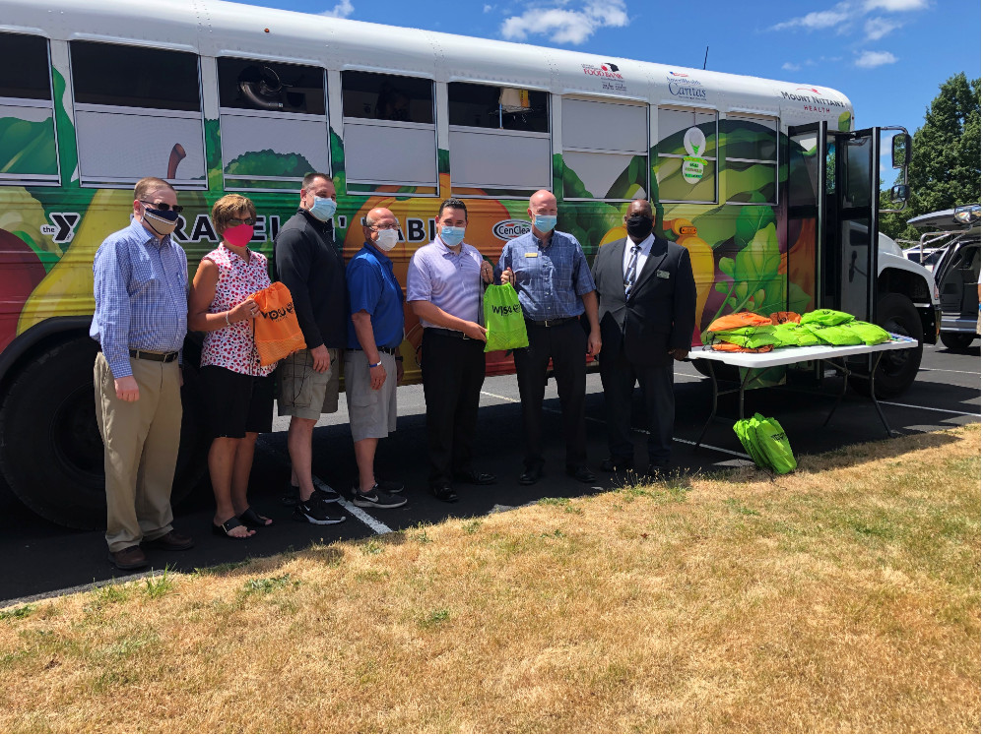
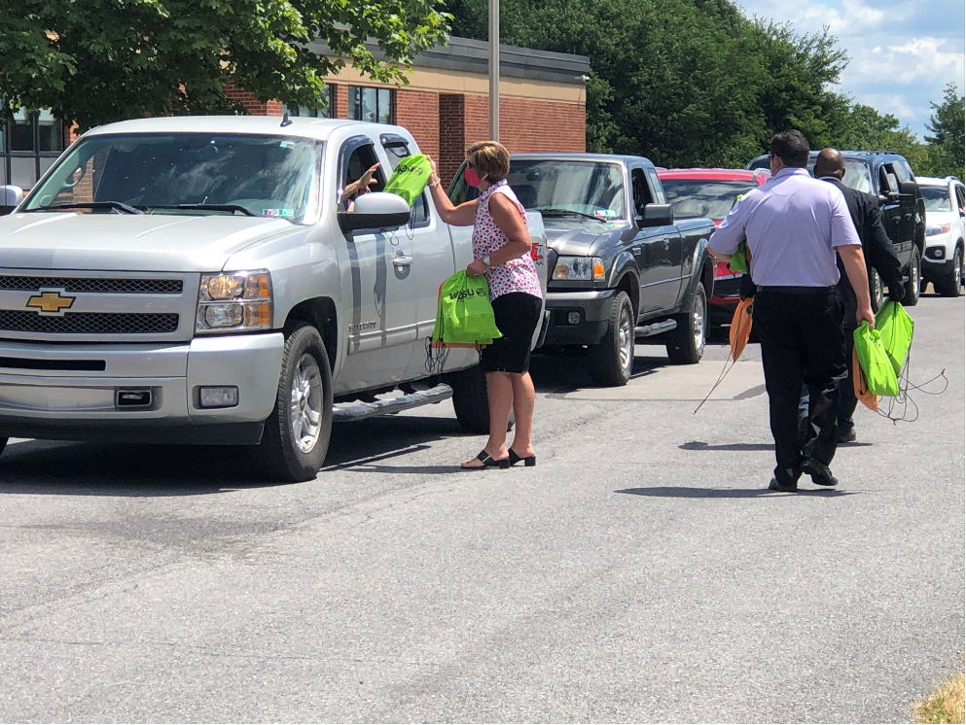

Slide 20
Mountaintop Elementary School

Slide 21
Mountaintop Elementary in Snowshoe, PA
(Pictured L-R)
Scott Graham, Superintendent, Bald Eagle Area School District
Cynthia Kunes, Field Representative, Rep. Glenn "GT" Thompson (15th US Congressional District)
Scott Mitchell, President/CEO, YMCA of Centre County
Mel Curtis, Director, Anti-Hunger Program, YMCA of Centre County
Matthew Wise, District Representative, Senator Jake Corman (PA-34th)
Mark Long, District Representative, Rep. Kerry Benninghoff (PA-171st)
Ernest Greene, District Representative, Rep. Stephanie Borowicz (PA - 76th)
WTAJ: Live at Noon and aired several stories through their evening newscasts as well.
https://www.wearecentralpa.com/news/local-news/centre-ymca-feeding-over-1000-kids-free-hot-meals/

Slide 22

Offline Partnership Grant
$50,000 grant from PDE
Work with IU’s 8,9,10
Purchase and load 450 Raspberry Pi devices with STEM and PBS Learning Media material
Delivery to offline students

Slide 23
Fall Learning at Home Initiatives
20 hours of educational children’s programming, consistent across the state
1 hour of regional programming
Color-coded schedules and linked activities
Learning at Home newsletter and social media posts
Potential hiring of Education Consultant by PA PBS collaborative
Promotion of PBS programming & PBS Learning Media assets

