Slide 1



WPSU Government Relations Committee
Greg Petersen, Gary Miller,
Matilda Illuzzi, Vince Mannino
Meeting on 8.11.20

Slide 2
Letters to the Editor - WPSU “Learning at Home” April-May-June 2020
Tim Asinger - Bradford Era
Sherry DelGrosso - Altoona Mirror
Kelly Hastings - Lock Haven Express
Matilda Illuzzi - Dubois Courier Express
Jennifer Judd - Bedford Gazette
John Lancy - Clearfield Progress
Joe Nairn - Warren Times Observer
John Pozza - Brookville Jeffersonian Democrat/Punxsutawney Spirit
Vince Mannino - Lewistown Gazette
Greg Petersen - Indiana Gazette
Greg Petersen - Johnstown Tribune Democrat
Greg Petersen - Mainline - (Ebensberg, Northern Cambria, Nanty Glo, Cresson, Gallitzin)
Greg Petersen - Huntingdon Daily News & Tyrone Daily Herald
Gary Miller - CDT
Gary Miller - Potter Leader-Enterprise
Gary Miller - Wellsboro Gazette

Slide 3

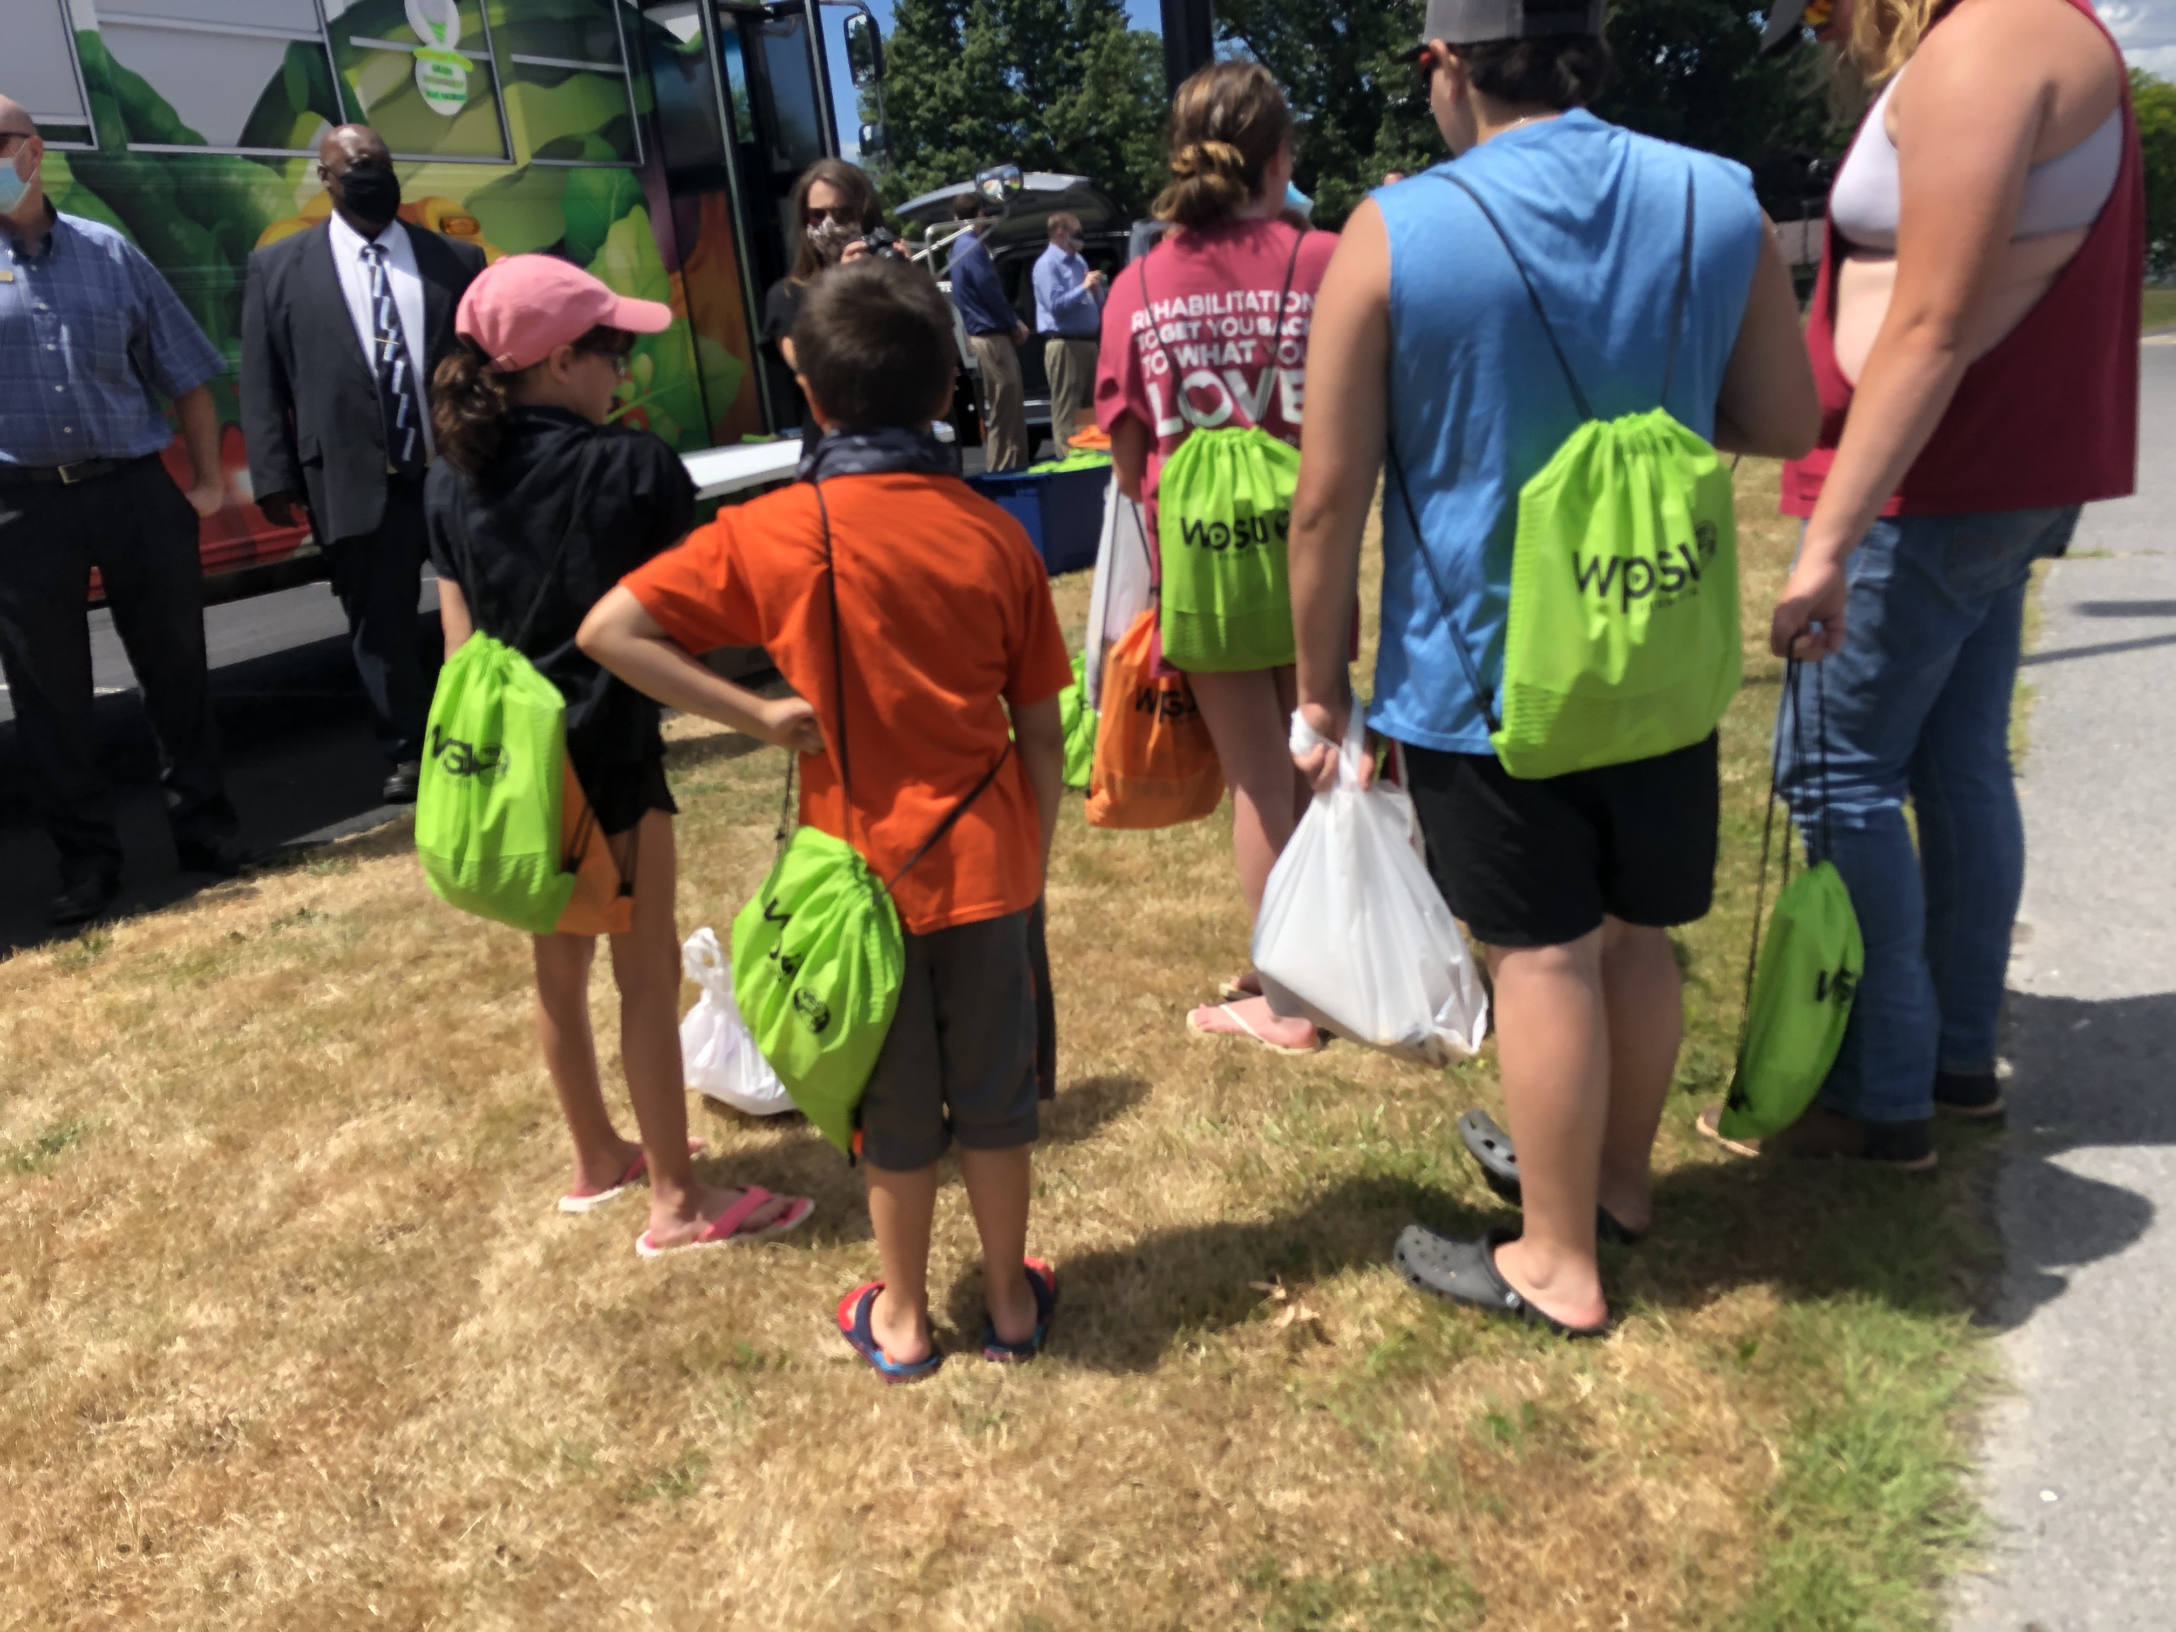
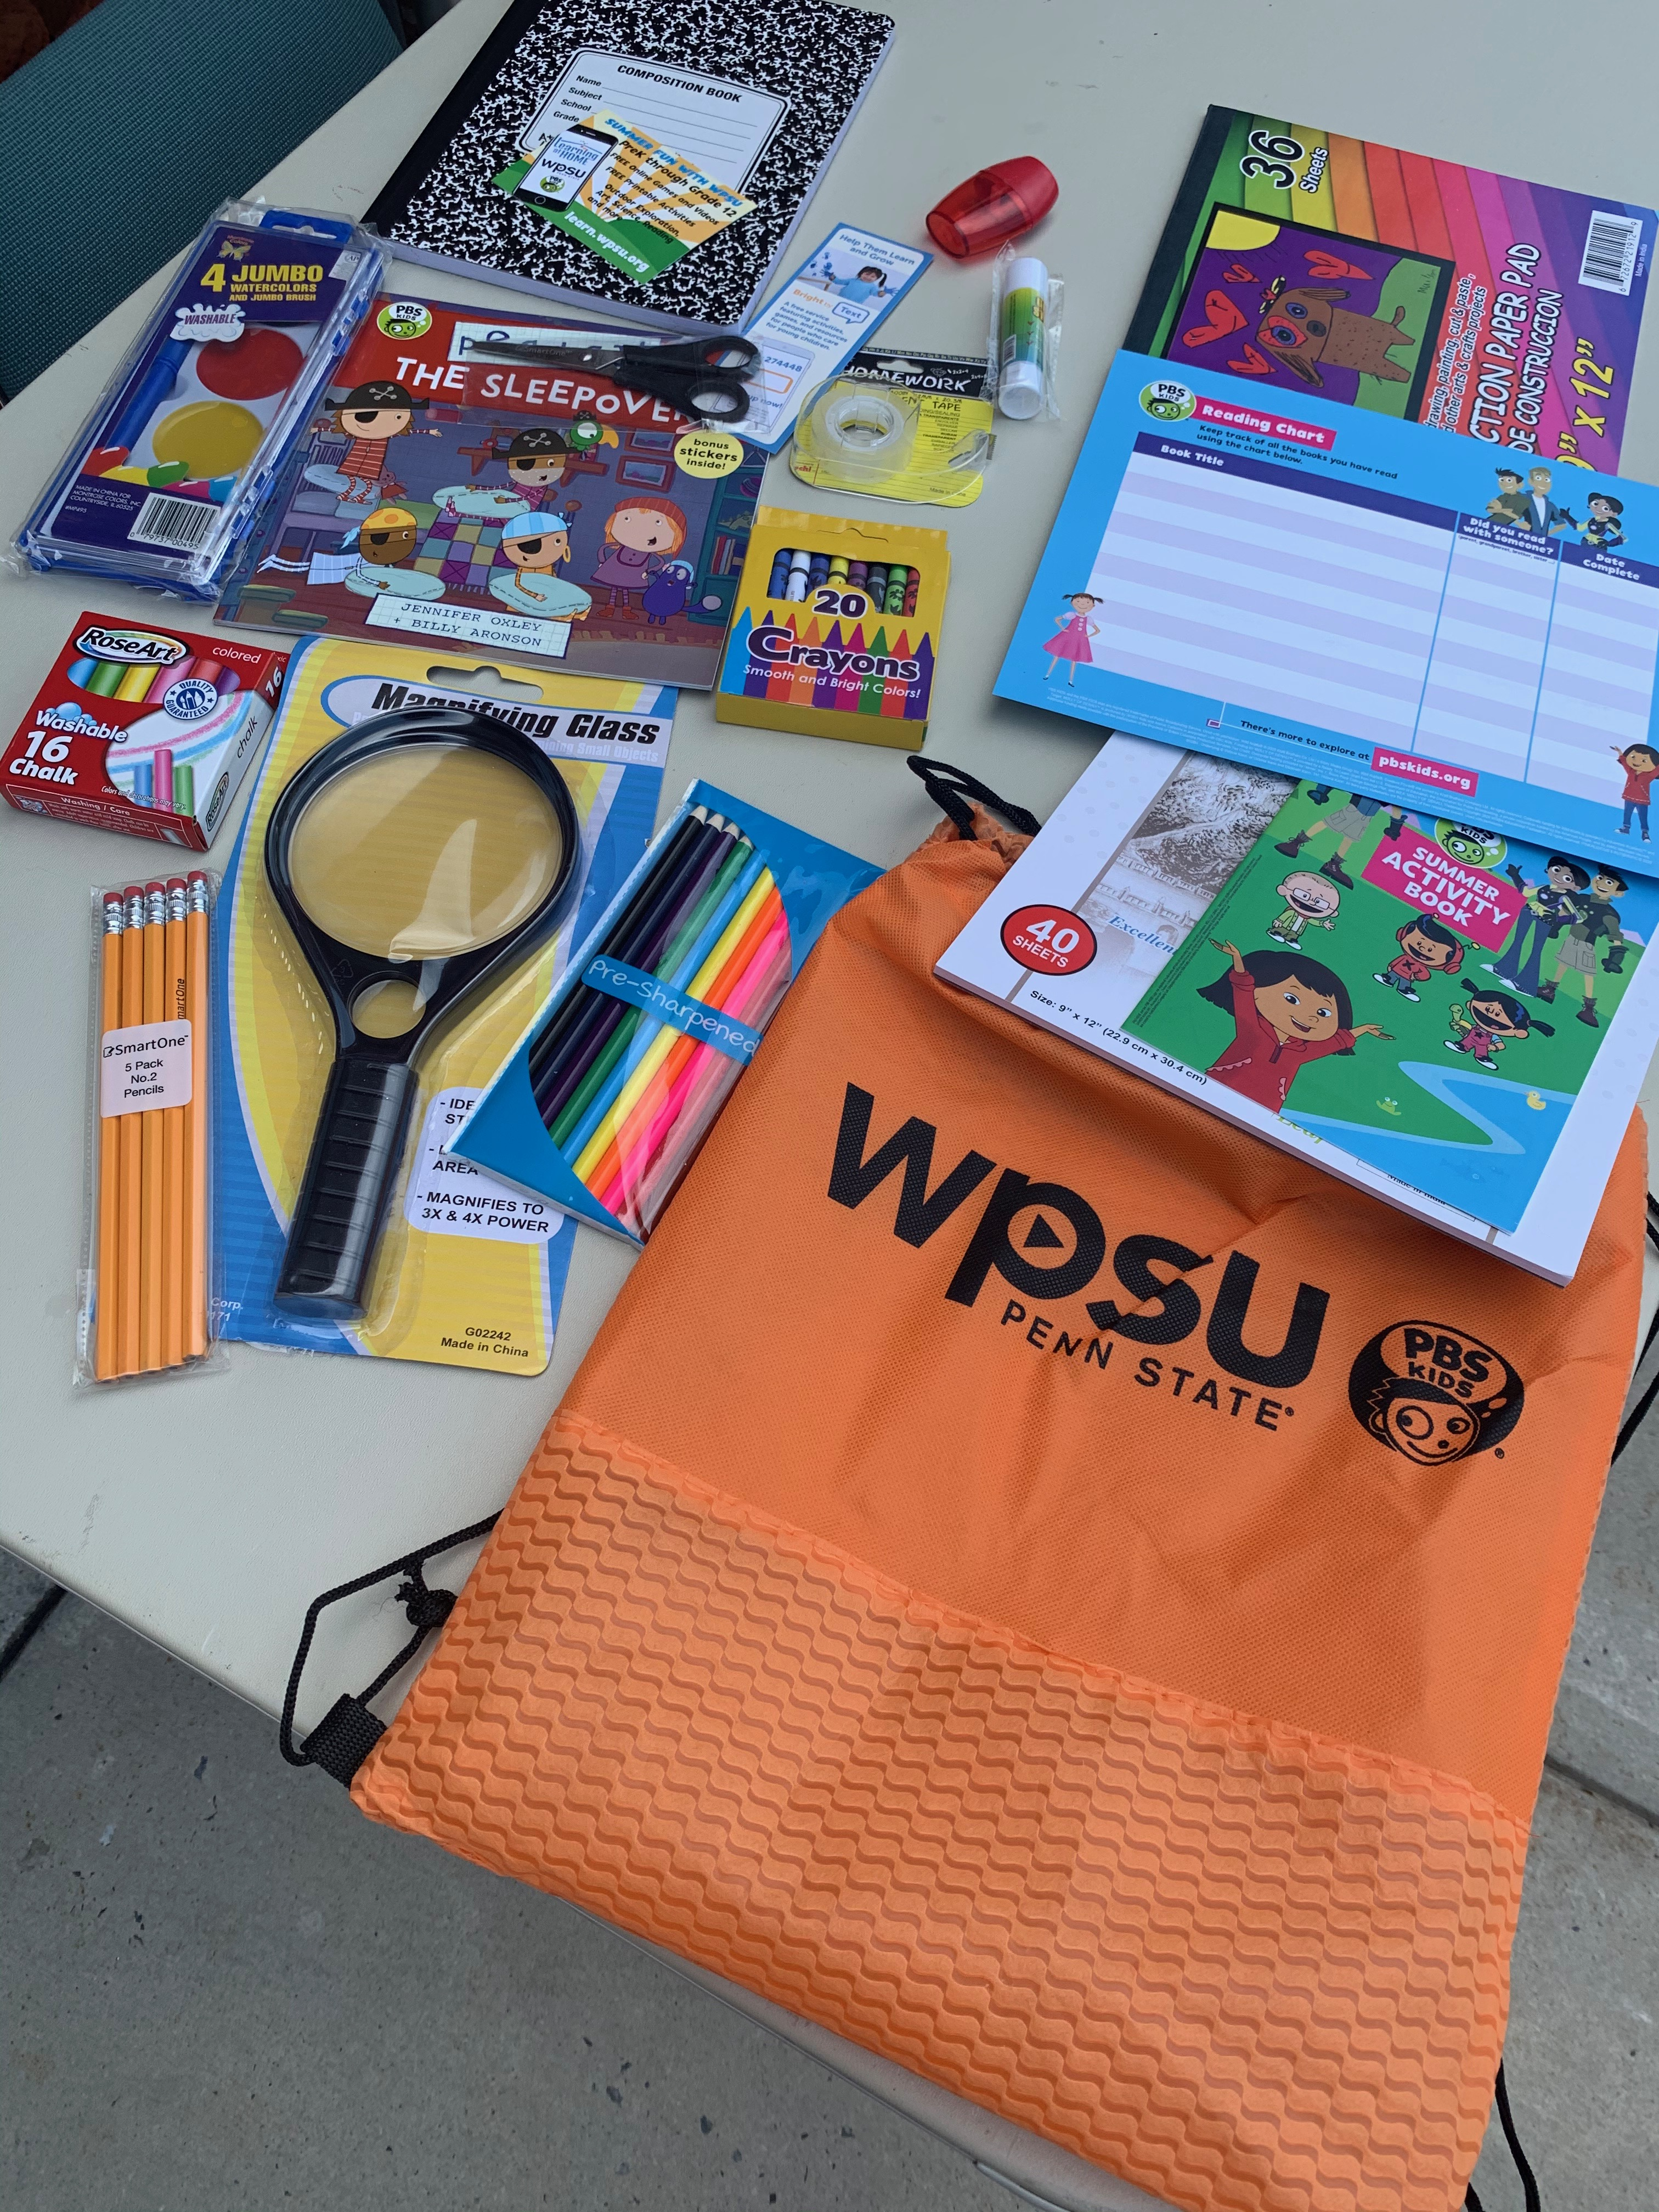
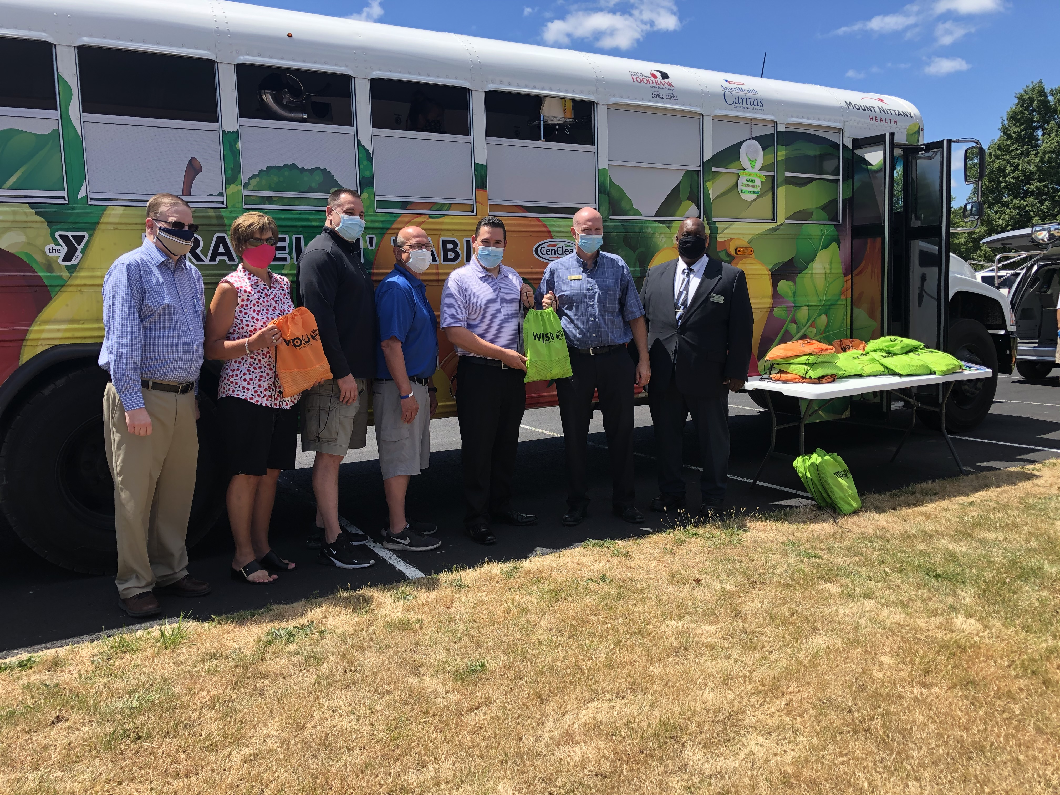
(Pictured Left to Right)
Scott Graham, Superintendent, Bald Eagle Area School District
Cynthia Kunes, Field Representative, Rep."GT" Thompson (15th US)
Scott Mitchell, President/CEO, YMCA of Centre County
Mel Curtis, Director, Anti-Hunger Program, YMCA of Centre County
Matthew Wise, District Representative, Senator Jake Corman (PA-34th)
Mark Long, District Representative, Rep. Kerry Benninghoff (PA-171st)
Ernest Greene, District Representative, Rep. Stephanie Borowicz (PA - 76th)

Slide 4


Slide 5
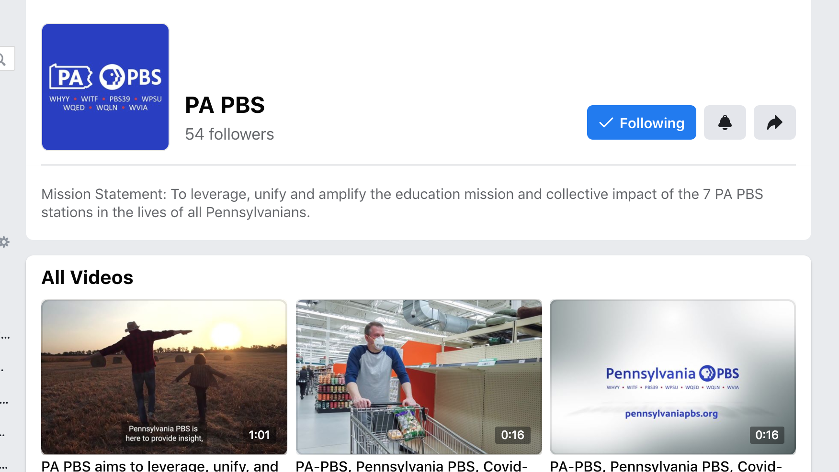
Notes:
https://www.facebook.com/watch/?v=3260164280732076

Slide 6
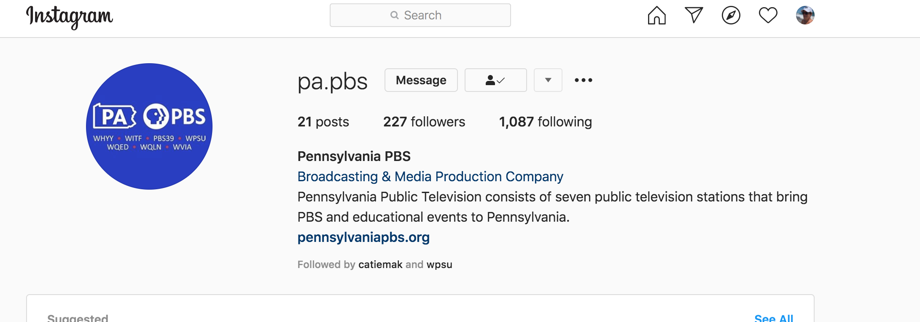
Notes:
https://www.instagram.com/pa.pbs/

Slide 7

Update on the movement of federal CARES/GEARS $ money to PA and PDE:
  PA PBS $12.7mm ask in for to support us through the Fall/Spring school year
  Following 7/17 meeting with PDE, Dep. Secretary Matt Stem and Governor Wolf met (confidential) to discuss Federal GEARS funding – Governor wants comprehensive solution that could scale/run for several years.
  SEE Scope of Work Proposal with PDE from PA PBS (sent in email out to committee)
$520k in total awarded across the state for PBS/IU beta projects:
  Recall that $520k in total was awarded across the state – WPSU participating with IU 8,9,10,11
  PBS stations and their IUs are meeting now to divide up work; submitted budgets
  Projects are a mix of Grab & Go bags and Raspberry Pi initiatives.
  The work must be started and the money spent by Dec 31, 2020.
$1.23mm Funding for Learning at Home PA through June 30:
  Still waiting confirmation that MCIU (Monroe County IU) has the funds and WITF can work with them for distribution; another hold up on PDE side; WPSU Share = $142,000 from FY2020

Slide 8
The PDE/PBS relationship beyond June 30:
  Press release announcing PAIU/PBS continued partnership for the fall is in process (WITF drafting) – Judd says to move forward with announcing PAIU and PBS for the fall.
  WITF working with PA First Lady to produce return to school related spots to coincide with start of new school year. Will use Pennsylvania PBS branding and website for these.
  PDE will have a series of planning webinars to discuss Fall education ie with IUs, superintendents, asst superintendents, curriculum, STEM, teachers, etc.
    Webinar 1 - first few weeks focus on operational planning
    Webinar 2 - next piece is strategic staffing
    Planning here is in progress with the IUs - Webinar 3 - will be curriculum, instruction and assessment
      Branded one-sheeters are being created for Teachers, Admins (principals, counselors), and sheet for teachers to give to parents about PBS resources
      PBS stations will host 3 webinars, and make them available for continued viewing. We would co-brand all 3 webinars and run on Thursdays at 3:30 PM:
        Week 1: 8/13 - Integrating PBS into your curriculum
        Week 2: 8/20 - Using PBS for SEL
        Week 3: 8/27 - Using PBS Learning Media

Slide 9
Senator | Joe | Scarnati | R (Retiring-25th) | President Pro Tempore | WPSU
Senator | Jake | Corman | R (34th-Centre) | Majority Leader | WPSU
Senator | Wayne | Langerholc | R (35th-Cambria) | Majority Education Chair/Member of Appropriations | WPSU | WQED
Senator | Joe | Pittman | R (41 – Indiana) | Member of Appropriations - WQLN/WQED | WPSU | WQED
Representative | Kerry | Benninghoff | R (171 – Centre) | House Majorty Leader | WPSU
Representative | Mike | Reese | R (59 - Somerset | Majority Caucus Secretary - WQED | WQED | WPSU
Representative | Donna | Oberlander | R(63Forest,Clarion) | House Majority Whip | WQED | WPSU
Representative | Mark | Gillen | R ( Lancaster) | Member of Education WITF | WPSU
Representative | Barbara | Gleim | R (Cumberland) | Member of Education- WITF | WPSU
Representative | Dave | Hickernell | R (Lancaster) | Member of Education - WITF | WPSU | WQLN
Representative | Lee | James | R( Venango) | Member of Appropriations – WQLN/WQED | WPSU | WQLN
Representative | Mike | Jones | R (York) | Member of Education - WITF | WPSU
Representative | Ryan | Warner | R(Fayette) | Member of Appropriations - WQED | WPSU

Slide 10
COVID19 UPDATES
Last week, the draft text of Senate Majority Leader Mitch McConnell’s (R-KY) HEALS Act was released and it included $175 million in additional relief funding for public broadcasting stations, the full amount we requested. This is the Senate Republican draft of the next COVID-19 relief package.
Negotiations with Senate Democrats, the House of Representatives, and the White House are still ongoing and it is unclear how quickly they will be able to reach an agreement as there are many substantial differences of opinion regarding what should be in the final package.
The public media funding proposed in the HEALS Act would go to the Corporation for Public Broadcasting (CPB) for distribution to all public television and radio stations to help address the many challenges presented by the coronavirus pandemic, both in terms of lost revenue and the cost of new services. It is in addition to the $75 million in emergency funding secured for public broadcasting in the CARES Act in March.

Slide 11
As APTS previously reported, the House of Representatives passed a six bill Fiscal Year (FY) 2021 appropriations package, including Labor-HHS-Education, which provides the majority of funding for public broadcasting.
The legislation includes the full funding we sought for every public broadcasting account in the Labor-HHS-Education bill including:
$515 million for CPB in FY 2023 — a $50 million increase, matching our request.
$20 million for Interconnection — level funding, matching our request.
$30 million for Ready To Learn — a $1 million increase, matching our request.
The FY 2021 appropriations bills will almost certainly not be completed until after the election, but it is essential that we continue talking to Members of Congress about the importance of this funding through the end of the process.
APTS encourages stations to keep up the steady drum beat of virtual meetings with your Members of Congress, especially during the August recess and other times this fall when Members will be back in the district and State. It is especially important to involve your community partners, if possible, in these meetings so that Members of Congress can see for themselves the impact that federal funding is having in their communities. All of this work should help build support when it comes time to finalize the FY 2021 funding bills.

Slide 12
Senator | Joe | Scarnati | R (Retiring-25th) | President Pro Tempore | WPSU
Senator | Jake | Corman | R (34th-Centre) | Majority Leader | WPSU
Senator | Wayne | Langerholc | R (35th-Cambria) | Majority Education Chair/Member of Appropriations | WPSU | WQED
Senator | Joe | Pittman | R (41 – Indiana) | Member of Appropriations - WQLN/WQED | WPSU | WQED
Representative | Kerry | Benninghoff | R (171 – Centre) | House Majorty Leader | WPSU
Representative | Mike | Reese | R (59 - Somerset | Majority Caucus Secretary - WQED | WQED | WPSU
Representative | Donna | Oberlander | R(63Forest,Clarion) | House Majority Whip | WQED | WPSU
Representative | Mark | Gillen | R ( Lancaster) | Member of Education WITF | WPSU
Representative | Barbara | Gleim | R (Cumberland) | Member of Education- WITF | WPSU
Representative | Dave | Hickernell | R (Lancaster) | Member of Education - WITF | WPSU | WQLN
Representative | Lee | James | R( Venango) | Member of Appropriations – WQLN/WQED | WPSU | WQLN
Representative | Mike | Jones | R (York) | Member of Education - WITF | WPSU
Representative | Ryan | Warner | R(Fayette) | Member of Appropriations - WQED | WPSU

Slide 13
